Slide 1

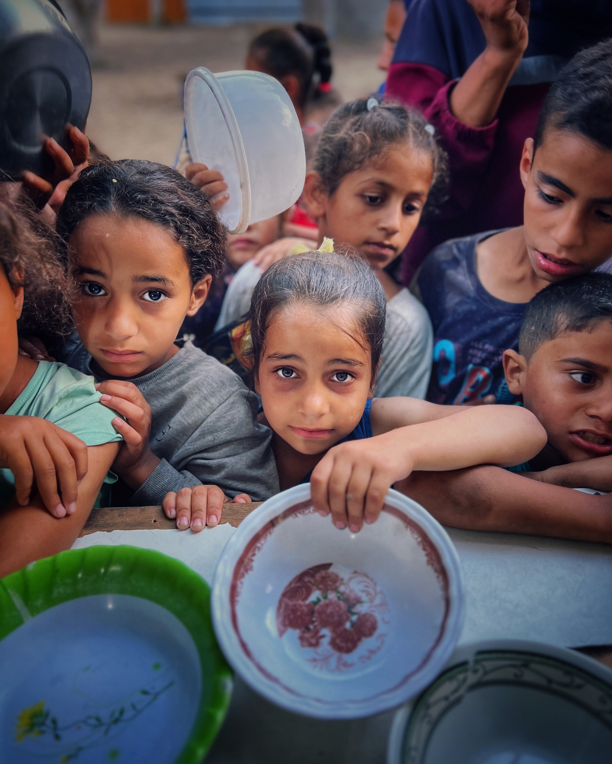
PRAYER POINT ONE
Basic Provisions
Christians in some of the world’s most hostile regions risk everything to follow Jesus.
Pray persecuted believers' physical needs are met with food, shelter, medical care, and other essentials for survival.
Millions of Christians in places like Sudan and Gaza have faced extreme famine and displacement in recent years. Due to their faith, they’re often last in line for humanitarian aid. They desperately need basics like food and water as well as safe shelter and medical care.

Slide 2
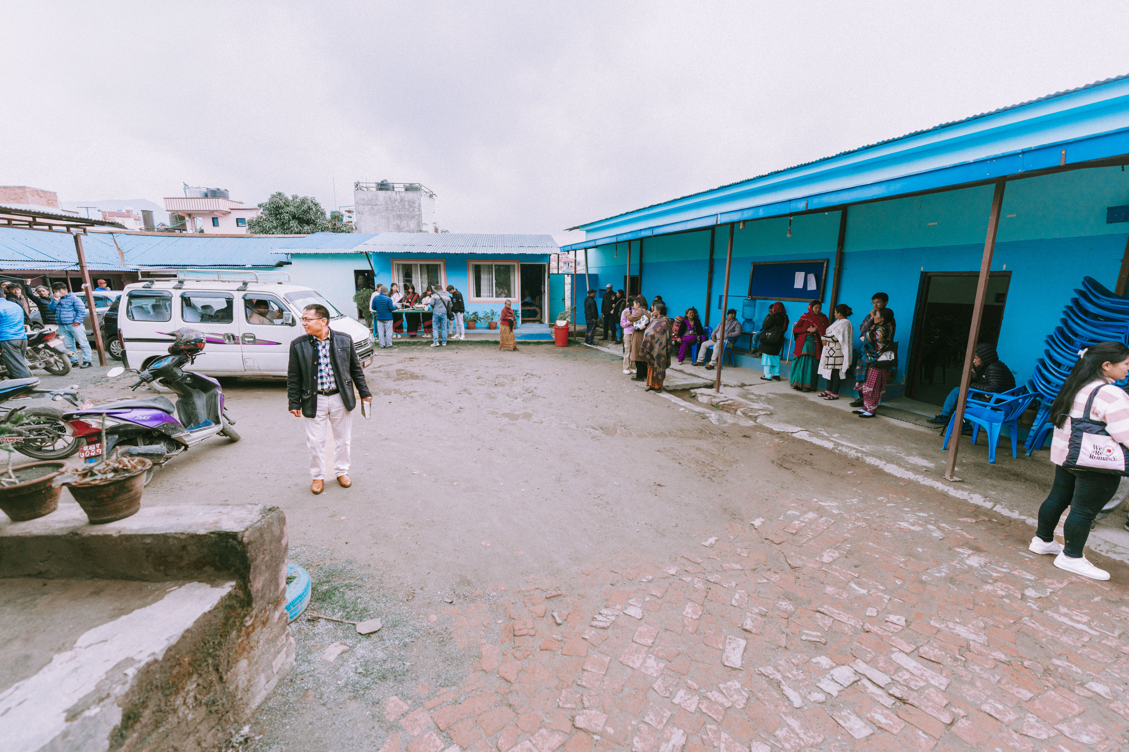
PRAYER POINT TWO
Unwavering Faith
Pray for the spiritual strength and endurance of believers facing daily pressure to abandon their faith and trust in the Lord.
Ramesh faced hostility, false accusations, and imprisonment for not renouncing his faith. Born into a family of Hindu priests that run 22 generations deep, Ramesh bucked tradition and strict anti-conversion laws in Nepal to follow Christ. His experience has only strengthened his resolve to continue sharing the Gospel.

Slide 3
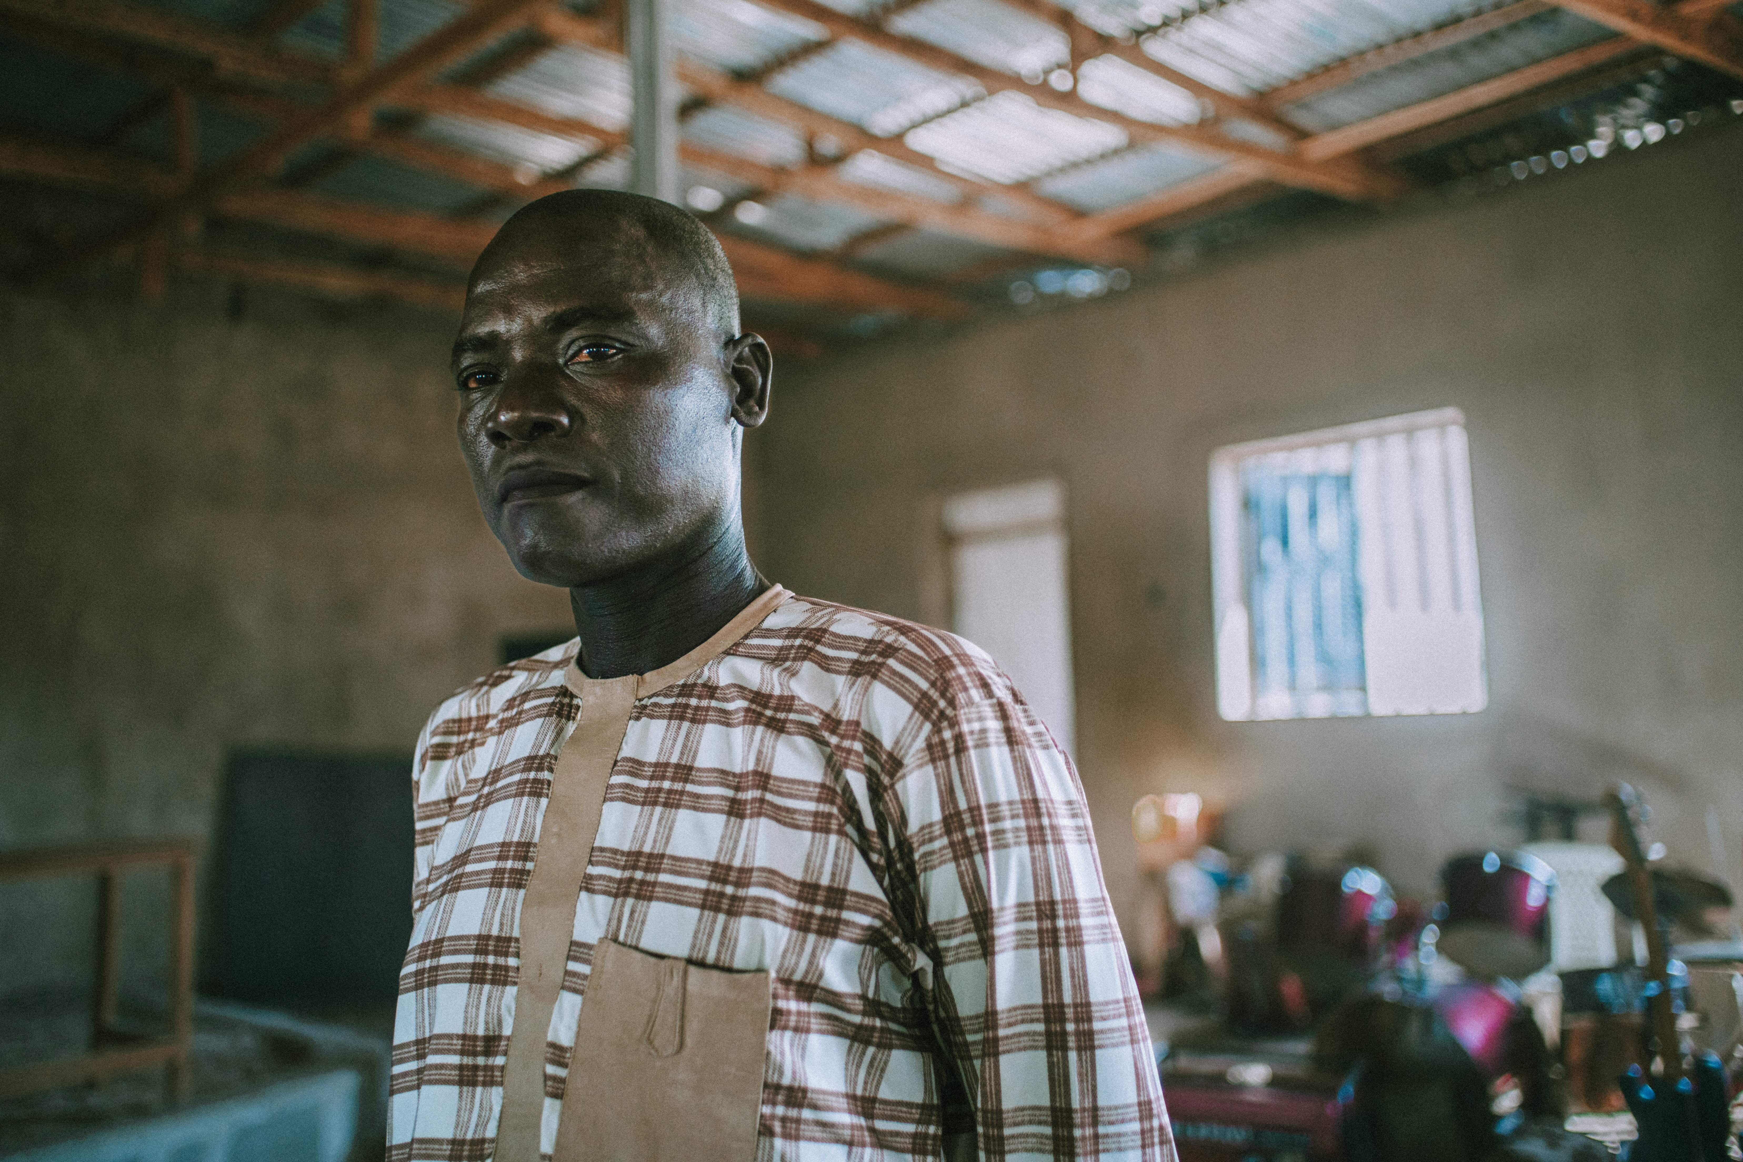
PRAYER POINT THREE
Protection of Church Leaders
Pray for the safety and wisdom of pastors, missionaries, and house church leaders serving in hostile regions. Pray they can be a source of comfort, support, and wisdom in shepherding their flock.
Pastor Paul’s* congregation was uprooted when extremists destroyed their entire community in Nigeria, the deadliest country for Christians. He now leads his flock at their displacement camp with remarkable faith and gratitude.
*Pastor Paul’s name has been changed for his safety.

Slide 4
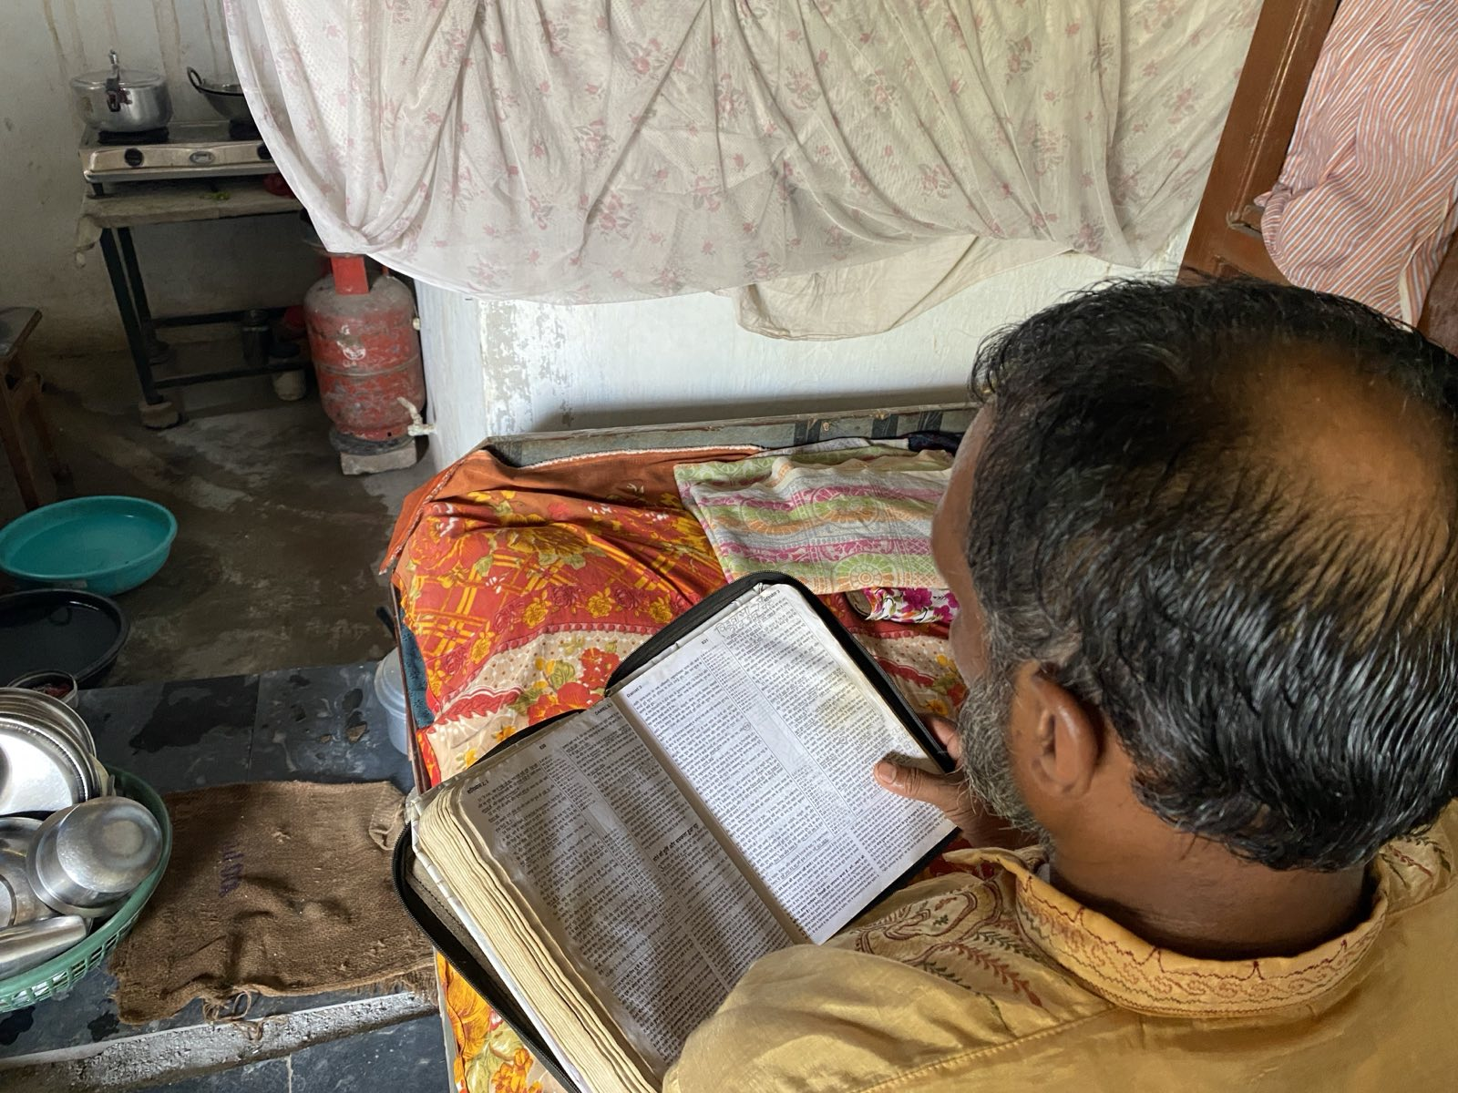
PRAYER POINT FOUR
Bold Witness
Pray for persecuted Christians to have courage to share their faith in their communities and for their testimonies to impact their persecutors.
Oppression has followed Vineet* since he came to faith in Christ. He’s been excommunicated and beaten and his home was bulldozed, yet he’s dedicated his life to sharing the Gospel in India.
*Vineet’s name has been changed for his safety.

Slide 5
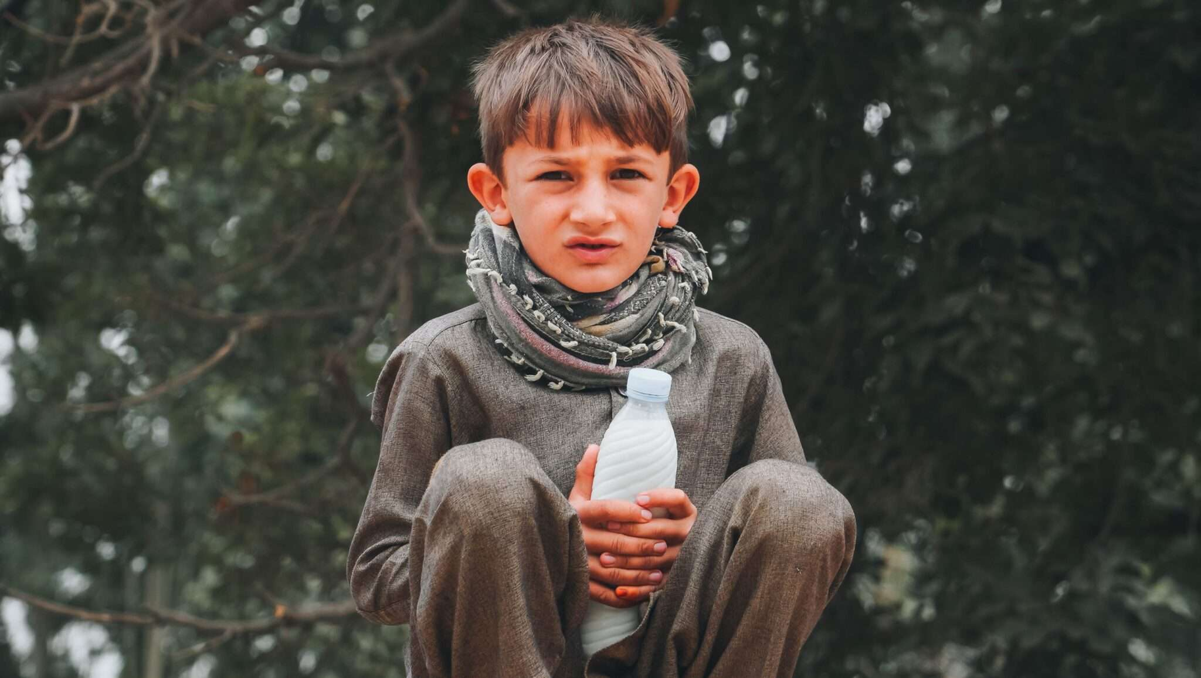
PRAYER POINT FIVE
Next Generation
Pray for Christian children and youth in persecuted regions to grow strong in faith despite opposition and limited resources. Ask the Lord to break generational cycles and empower the new generation for a better life.
Akram* was 10 when the Taliban took control of Afghanistan and his family’s livelihood. His family fled to Pakistan where Akram was beaten and stabbed for leaving Islam. Despite the severe persecution they face, they hold fast to their faith and find their eternal strength in Jesus to continue.
*Akram’s name has been changed for his safety.

Slide 6
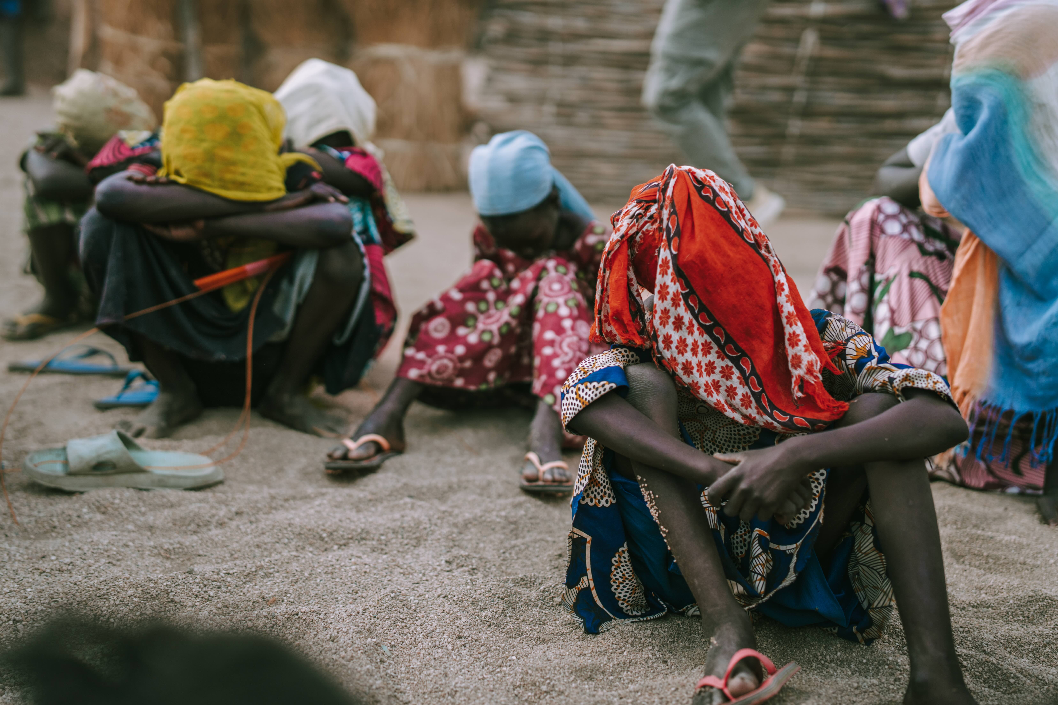
PRAYER POINT SIX
Global Church Awakening
Pray for Christians in free nations like the U.S. to become aware, engaged, and active in supporting their persecuted family. Allow their stories and experiences to move us and deepen our faith.
News about Christian persecution isn’t usually covered by mainstream media, and so many American Christians aren’t aware of the scope of oppression around the world. But once we know about the trials and needs of our brothers and sisters in Christ, it’s in our DNA to pray for and support those who suffer for their faith in Jesus.

Slide 7
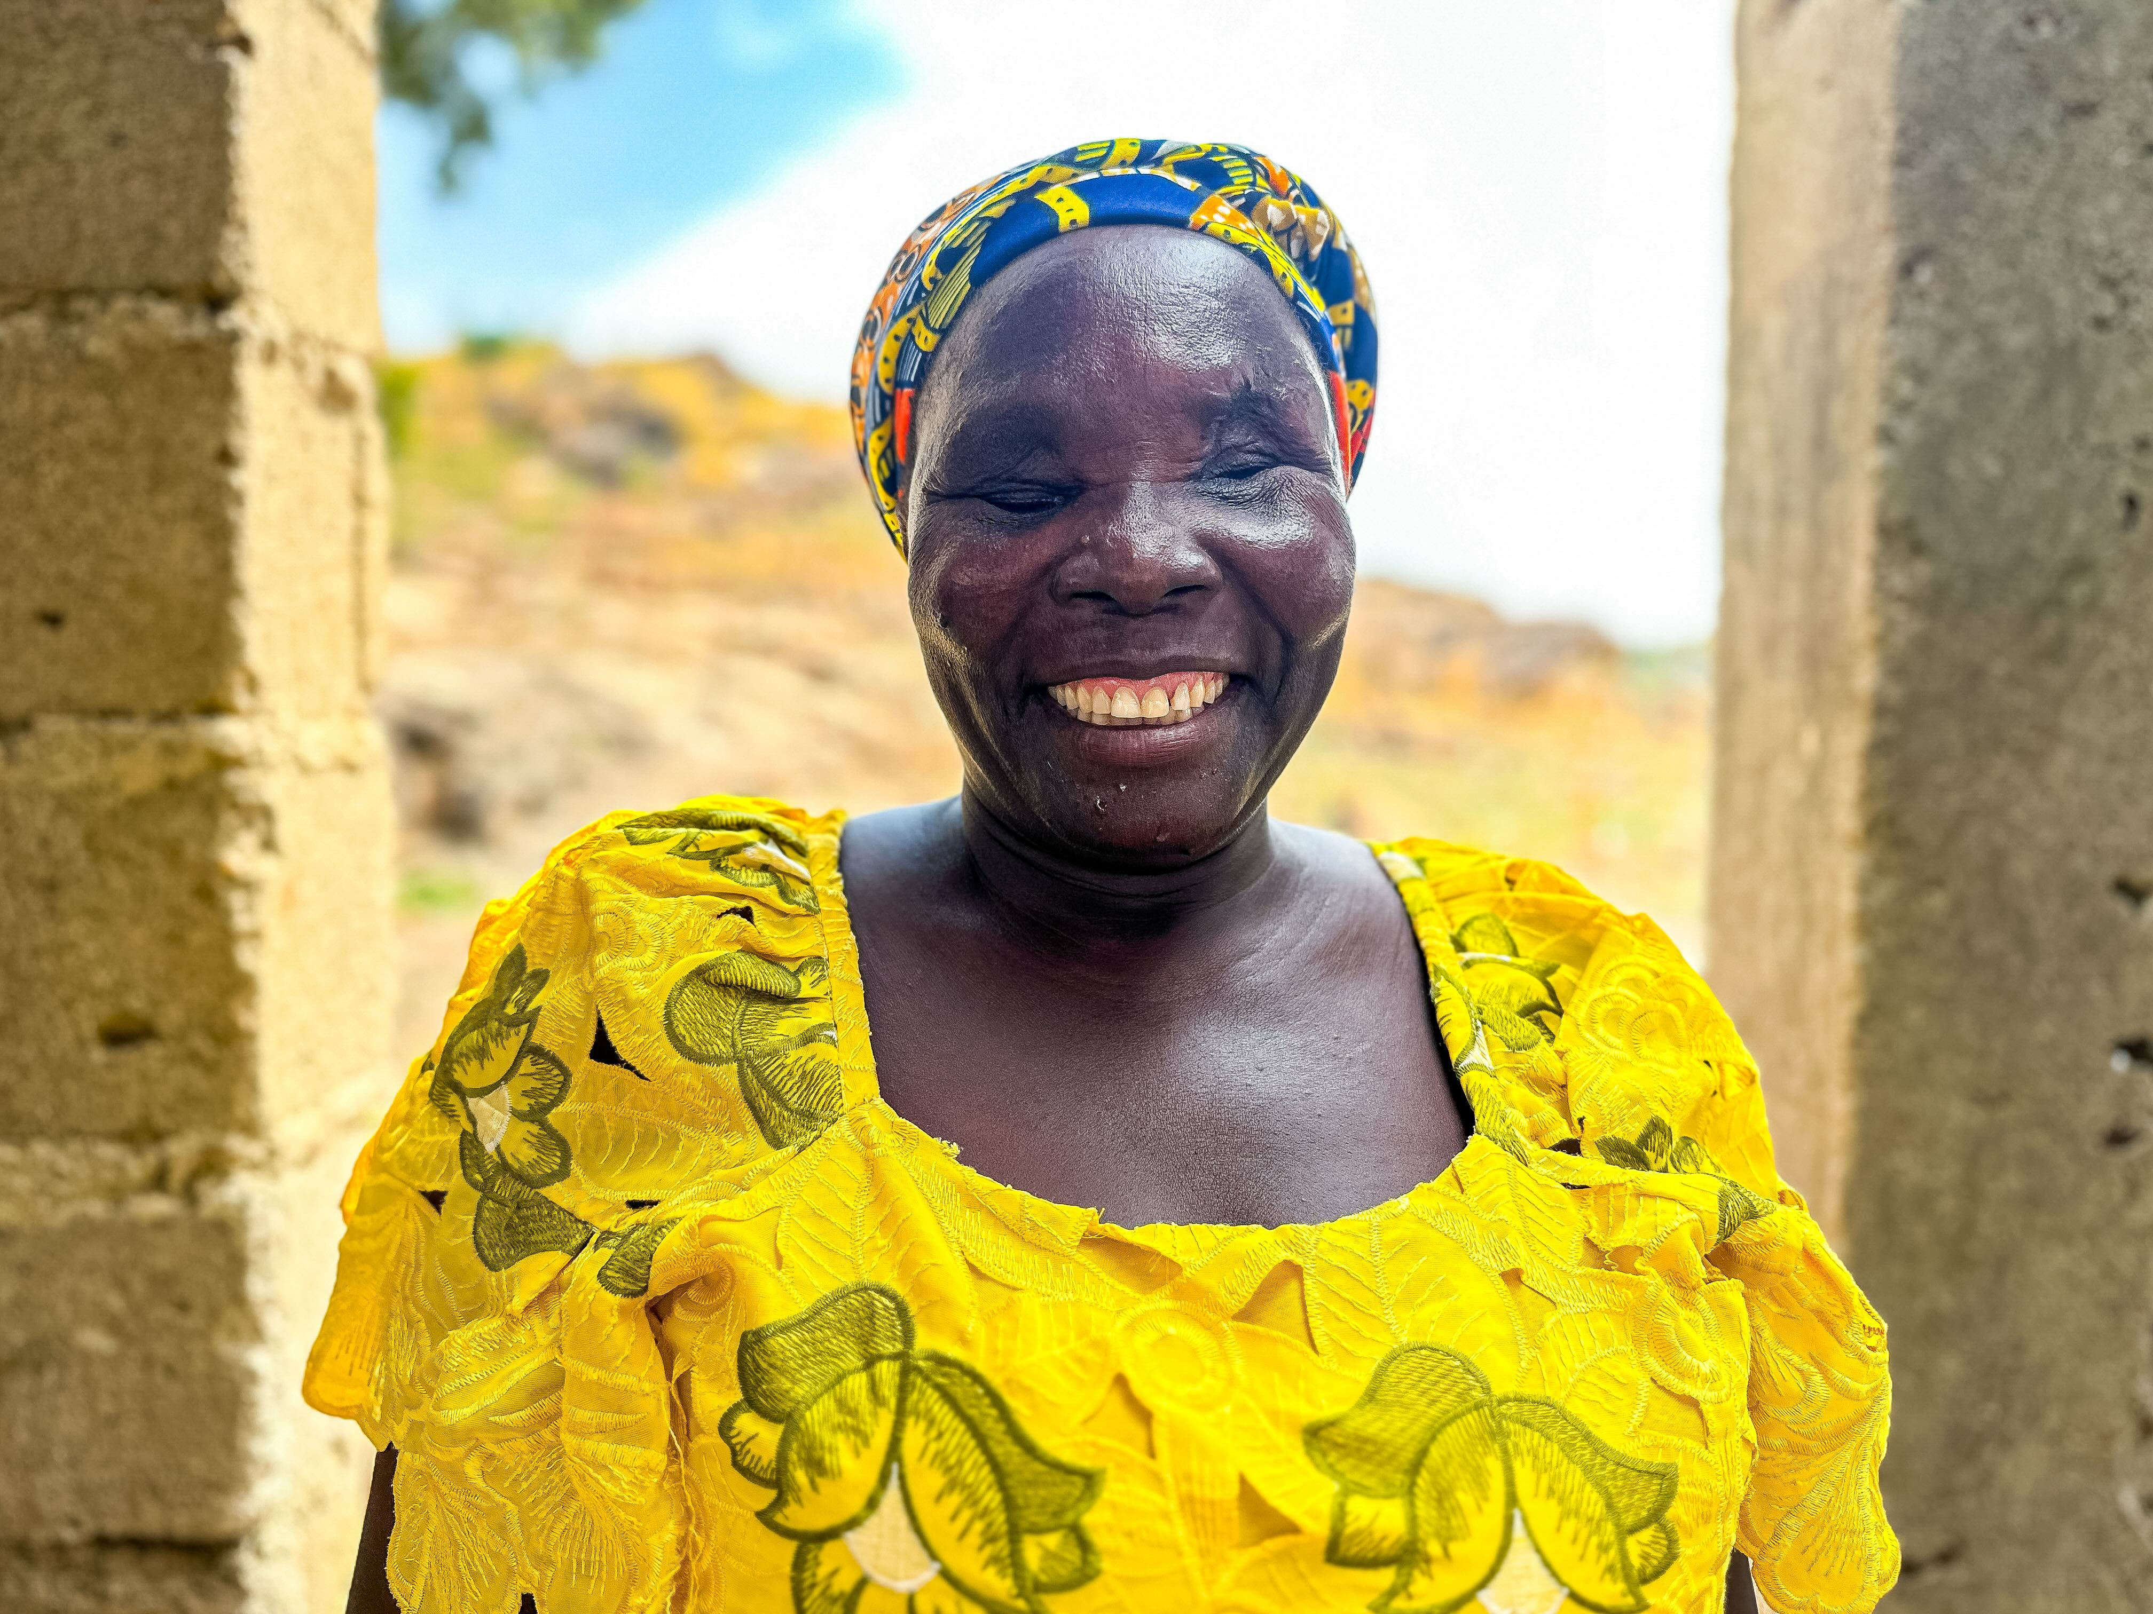
PRAYER POINT SEVEN
Comfort and Hope
Pray for those grieving loved ones lost to persecution, asking for God's presence, healing, and hope.
With a gun to her head as Boko Haram ransacked her village, Suzanne refused to renounce her faith. One bullet took her eyesight and another took her father. Through her tragic loss, she’s found joy and forgiveness in her heavenly Father.

Slide 8
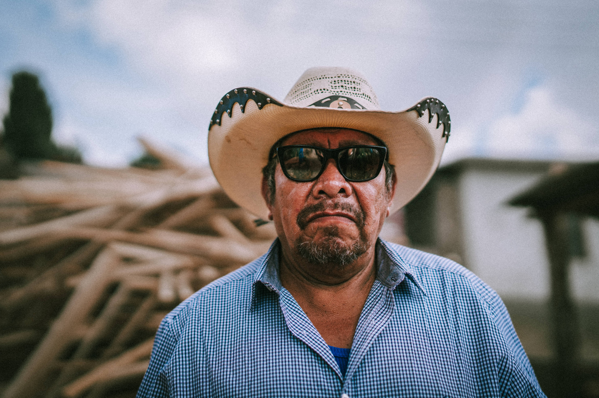
PRAYER POINT EIGHT
Hearts of Persecutors
Pray for those who oppose and persecute Christians to encounter God's truth and experience transformation and have mercy on those they persecute.
Once deeply connected to the Zapatistas, an anti-government revolutionary movement in Mexico, Aurelio was hostile to Christianity. But when he finally heard Scripture, everything changed. Now Aurelio shares the Word of God everywhere he goes.

Slide 9
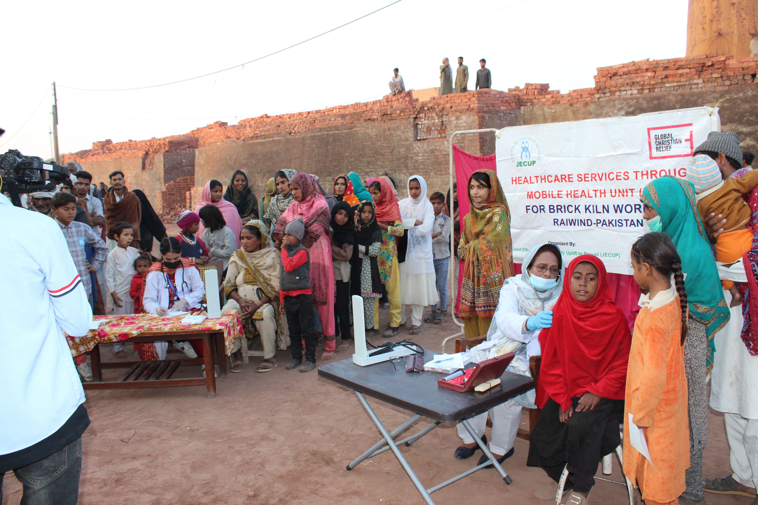
PRAYER POINT NINE
Aid Workers and Organizations
Pray for the safety, effectiveness, and resource multiplication of the organizations and relief workers serving persecuted believers.
Christians make up a disproportionate majority of Pakistan’s brick kiln industry, often forced into bonded labor because of their undesirable place in society. These workers are prone to chronic respiratory issues with the constant exposure to dust and smoke and lack of access to medical care. Our community recently helped free 50 families from their debt and supplied free healthcare to more than 14,000 impoverished Christians in Pakistan.

Slide 10
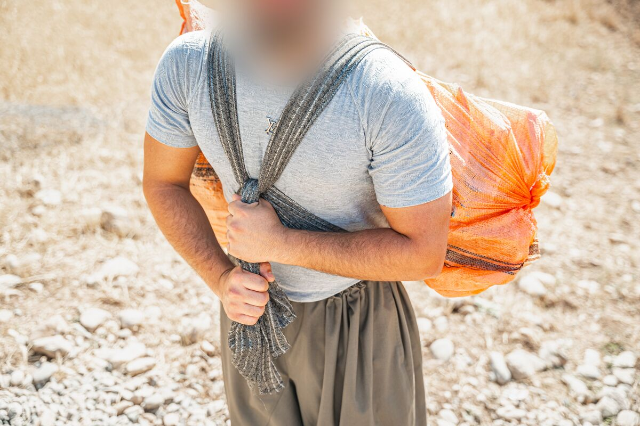
PRAYER POINT TEN
Religious Freedom
Pray for the reduction of religious tensions, the change of discriminatory laws, and increased freedom to worship openly.
Once a radical follower of Islam, Azad’s* heart softened to Jesus following a powerful dream. Now a member of the underground church in the Middle East, Azad smuggles Bibles across the border in the middle of the night so more people can hear the Word.
*Azad’s name has been changed for his safety.

